Slide 1


RENGANAYAGI VARATHARAJ COLLEGE OF ENGINEERING
AI FOR SMARTCITIES AND TRANSPORTATION
SafeGas AI: An Intelligent AI-Powered LPG Leakage Prediction and Smart Safety System
TEAM NAME : SentinelX AI
TEAM ID : H26SCT08
TEAM LEADER : HARISH RAJ G
TEAM MEMBERS: SIRANJEEVI K
SURESH V

Slide 2
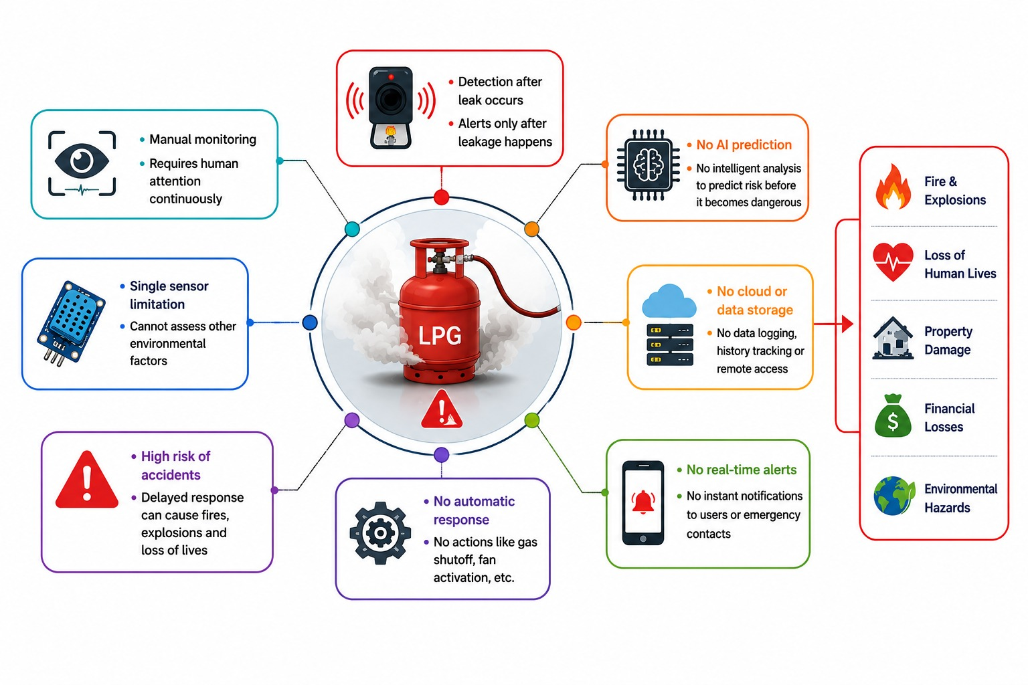
PROBLEM STATEMENT
LPG gas leakage is a major cause of fires and explosions.
Traditional systems detect gas leaks only after leakage occurs.
Most existing systems rely on a single gas sensor.
They cannot predict accidents before they become dangerous.
There is no real-time monitoring or remote alert system.
Delayed response can lead to loss of lives and property damage.
An AI-powered smart safety system is needed for early prediction and automatic prevention

Slide 3
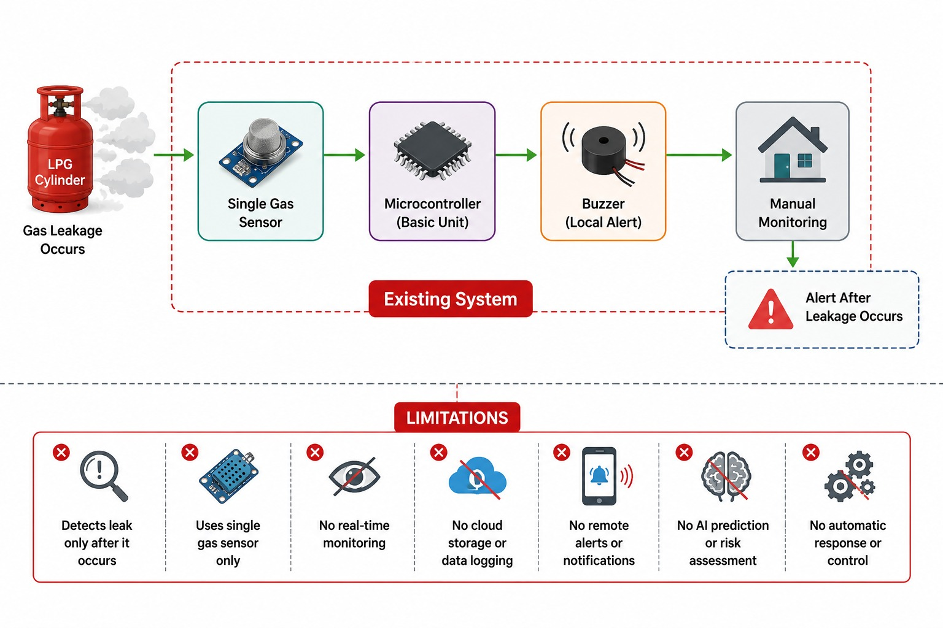
EXISTING SYSTEM
Traditional systems use only a single LPG gas sensor for detection.
Gas leakage is detected only after the gas has already leaked.
A local buzzer is activated, requiring manual user intervention.
No AI-based analysis or accident risk prediction is available.
No cloud storage or historical data monitoring.
No remote notifications or emergency alerts are provided.
Delayed detection increases the risk of fire, explosions, and property damage.

Slide 4
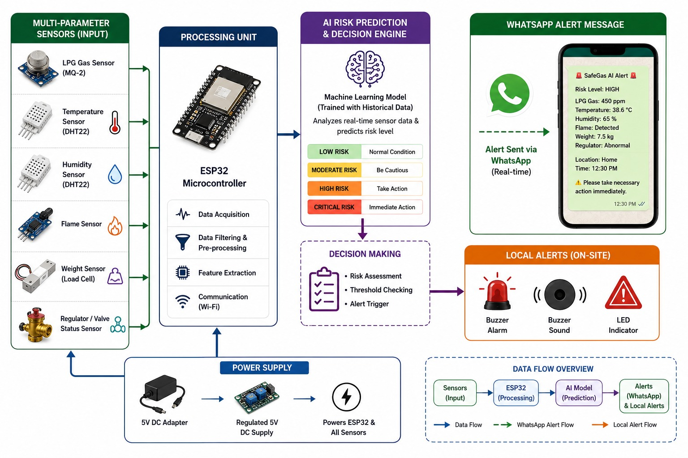
OUR INNOVATION
ESP32 collects real-time data from gas, temperature, humidity, and flame sensors.
Sensor data is sent to the Flask application through USB serial communication.
The AI engine analyzes the data and predicts the current risk level.
If a high-risk condition is detected, the buzzer and exhaust fan are activated automatically.
Emergency WhatsApp alerts are sent instantly with the risk status and sensor readings.
All data is stored in the database and displayed on a live dashboard for real-time monitoring.

Slide 5
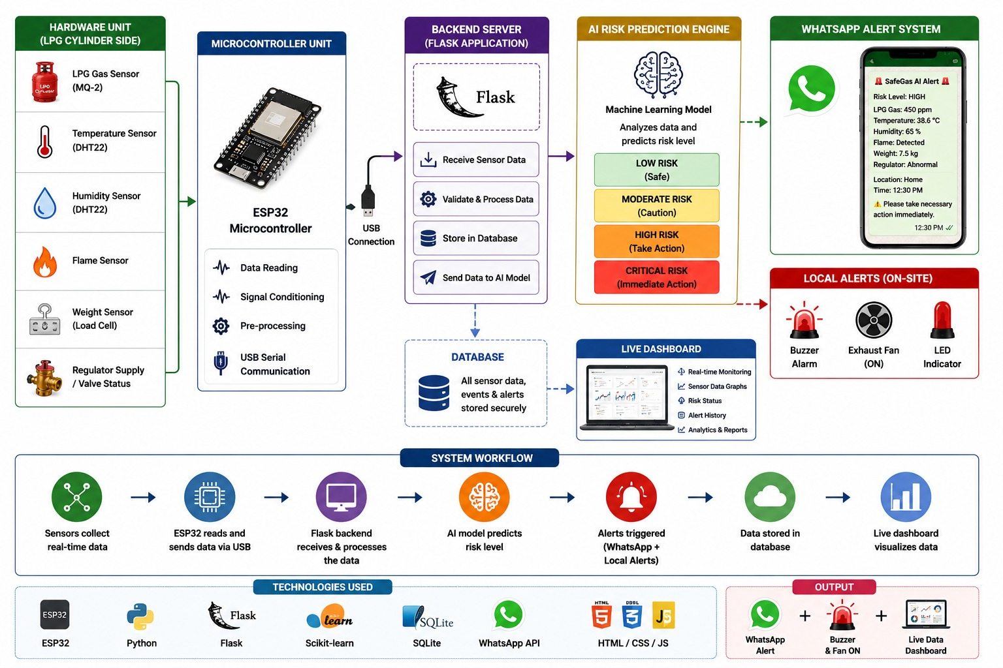
SYSTEM ARCHITECTURE
ESP32 collects real-time data from gas, temperature, humidity, and flame sensors.
The sensor data is sent to the Flask backend for processing.
AI analyzes the data and predicts the current risk level.
If a dangerous condition is detected, the buzzer and exhaust fan turn on automatically.
WhatsApp alerts are sent instantly to notify the user about the emergency.
A live dashboard displays sensor data, alerts, and system status for continuous monitoring

Slide 6
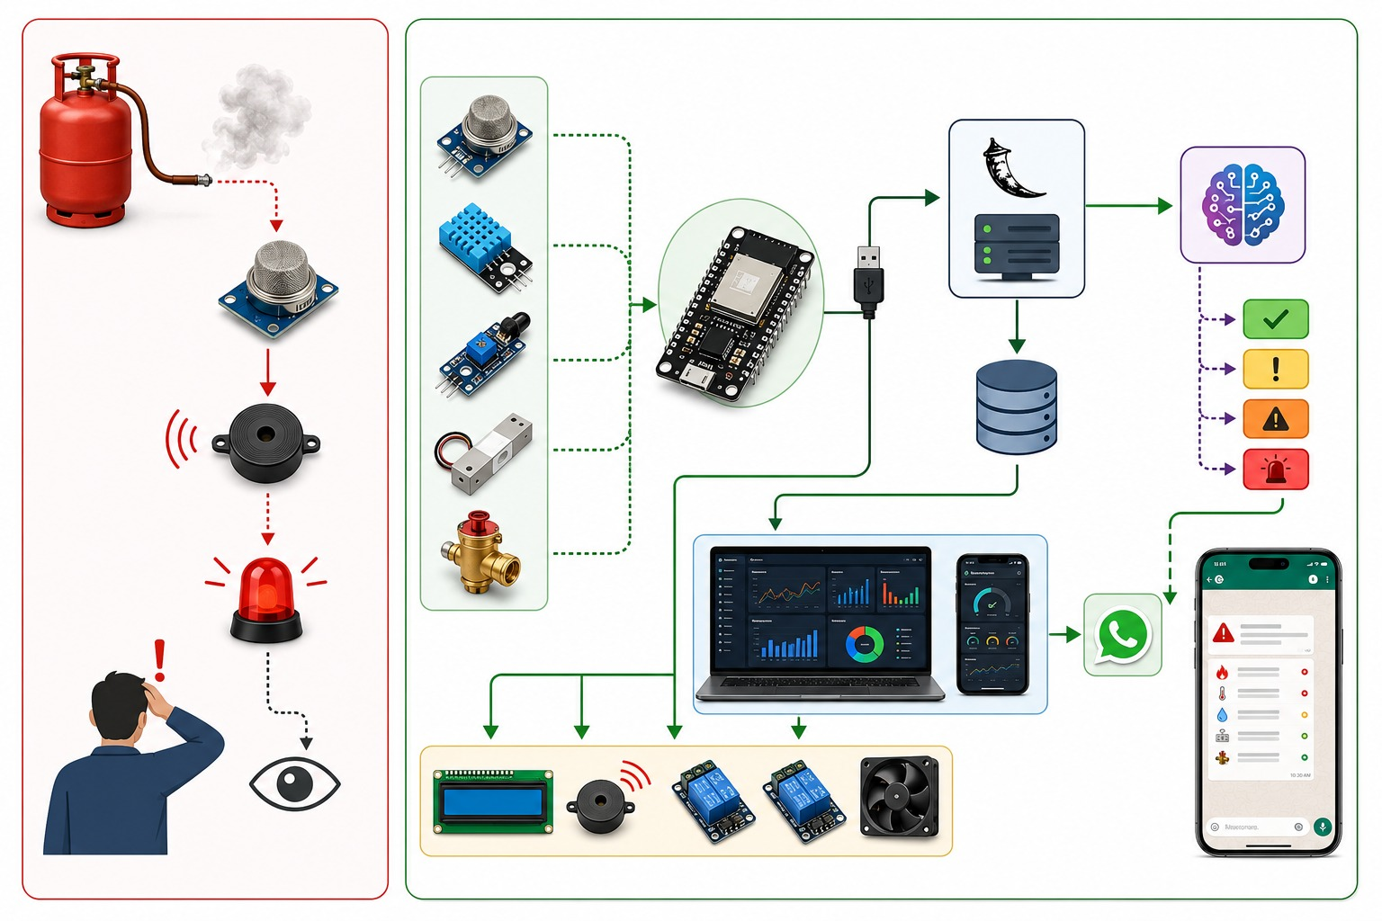
EXISTING SYSTEM VS SENTINELX AI
Traditional systems detect gas leaks only after leakage occurs, while SafeGas AI predicts potential risks before accidents happen.
Existing systems use a single gas sensor, whereas SafeGas AI integrates multiple sensors for accurate monitoring.
Traditional systems provide only a local buzzer alert, while SafeGas AI sends instant WhatsApp notifications.
Existing systems require manual action, whereas SafeGas AI automatically activates the buzzer and exhaust fan.
Traditional systems do not support cloud monitoring, while SafeGas AI provides a real-time web dashboard with data storage.
By combining IoT, AI, Flask, and WhatsApp automation, SafeGas AI offers a smarter, faster, and more reliable LPG safety solution.

Slide 7
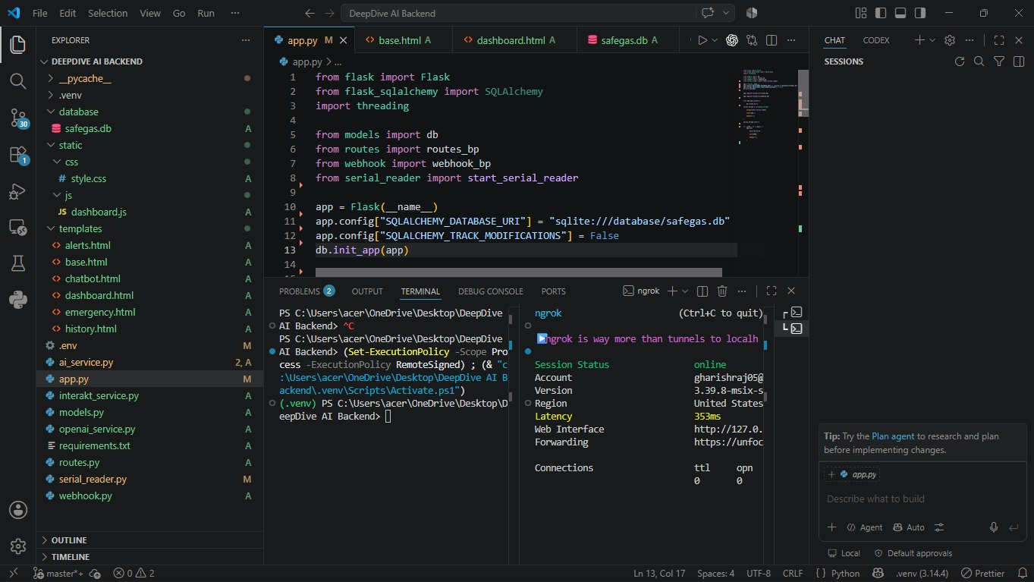
IMPLEMENTATION PROGRESS

Slide 8
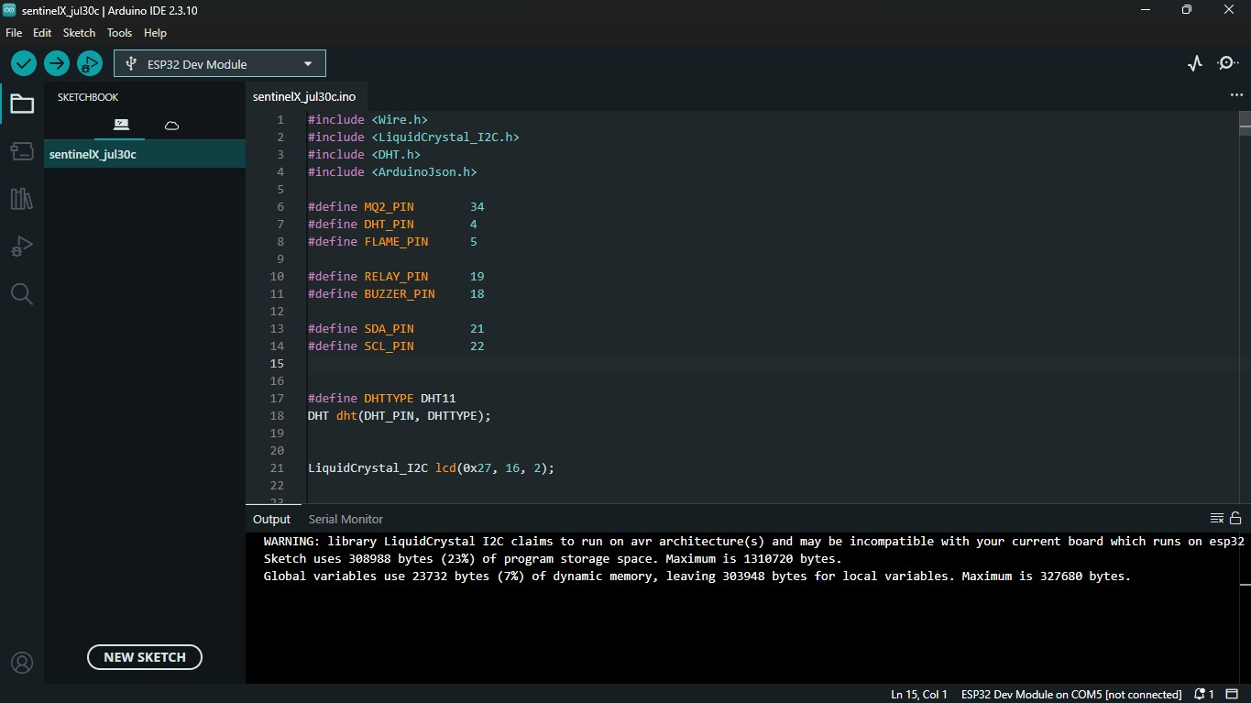
IMPLEMENTATION PROGRESS

Slide 9
